Slide 1
Designing User Interface with Views
Unit 4

Slide 2
Content
Basic Views
Picker Views
List View to Display long lists
Specialized Fragments

Slide 3
View
A View is a simple building block of a user interface.
It is a small rectangular box that can be TextView, EditText, or even a button.
It occupies the area on the screen in a rectangular area and is responsible for drawing and event handling.
View is a superclass of all the graphical user interface components.

Slide 4
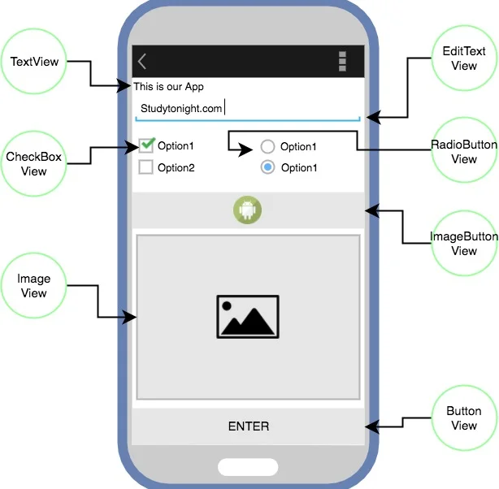
Basic Views
TextView
The TextView control is a classic text label.
It used to display a certain text to the user.
The text to be displayed to the user can be set by the android:text property.
Button
Button represents a clickable push-button widget.
It is used to perform some task when user presses a Button view.
The task to be performed can be coded into the Java file in the form of user defined function and linked to the button view using the android:onclick property.
An onClick() callback method can also be defined in the Java file to perform a specific task on click of the button.

Slide 5
Basic Views
ImageButton
Image button works like a normal button but with image displayed instead of a text.
To set the image we must assign an image resource to the android property android:src.
EditText
EditText is widget that displays an empty text field in which a user can enter some text.
android:inputType property is used to indicates the type of content that will be entered in the text box, such as an email address, password, phone number, web or just plain text.
android:hint property is used to display the hint text when text is empty.

Slide 6
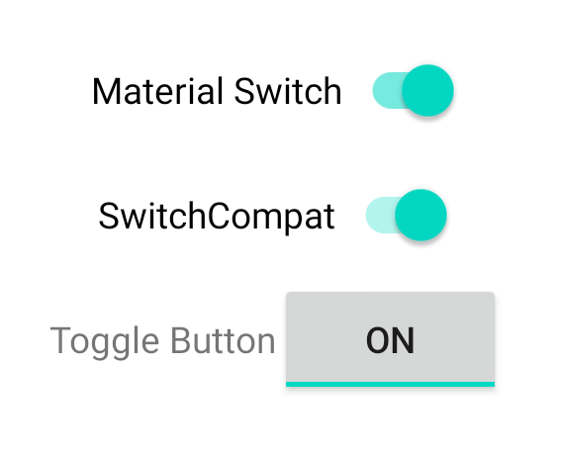
Basic Views
CheckBox
CheckBox is used to mark or unmark options in an application.
It should be used when there are multiple options, and the users can choose more than one option.
The property android:checked is used specify the current state of the CheckBox (Checked/Unchecked)
ToggleButton
ToggleButton is a type of button that can remain in two possible states, pressed or not-pressed.
The properties android:textOn and android:TextOff should be specified to display the required text on the ToggleButton when it pressed or not-pressed.

Slide 7
Basic Views
RadioButton
A RadioButton is a button that has two states, that are either checked or unchecked.
Once a RadioButton gets into the checked state we cannot undo it.
It should be used to let the user select one option from a set of options.
RadioGroup
Radio Group is a group that contains a set of radio buttons.
Among all the available Radio buttons inside a RadioGroup, only one can be chosen.
After selecting a Radio button if we select some other Radio button, then the previous one gets deselected.

Slide 8
Basic Views
ProgressBar
Android ProgressBar is a graphical view indicator that shows some progress. It displays a bar or spinning wheel animation to represent progress of a task.
android:max: To set the maximum value of the ProgressBar. By default the progress bar maximum value is 100
android:indeterminate: A boolean value is set depending on whether the time is determinate or not. Setting this attribute to false would show the actual progress. Else if it’s set to true a cyclic animation is displayed to show that progress is happening.
android:progress: It is used to set the number by which the progress bar value will be incremented.
style: By default, the progress bar will be displayed as a spinning wheel. If we want it to be displayed as a horizontal bar, we need to set the attribute as : style=“?android:attr/progressBarStyleHorizontal”

Slide 9
Basic Views
AutoCompleteTextView
AutoCompleteTextView is a view similar to EditText, except that it shows a list of completion suggestions automatically while the user is typing.
The list of suggestions is displayed in drop down menu. The user can choose an item from there to replace the content of edit box with.
The ArrayAdapter object manages the array of strings that will be displayed by the AutoCompleteTextView.
The setAdapter() method is used to set an ArrayAdapter object containing the suggestion list.
The setThreshold() method sets the minimum number of characters the user must type before the suggestions appear as a drop-down menu. For example, textView.setThreshold(3), suggestions will be shown after the user enters 3 characters.

Slide 10
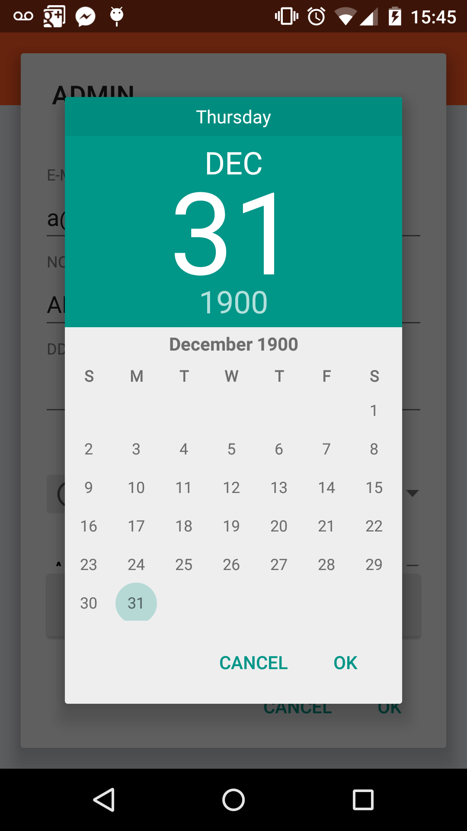
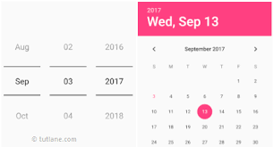
Picker Views
DatePicker
DatePicker is a widget used to select a date.
It allows to select date by day, month and year in your custom UI.
It provides two modes – Spinner and Calendar(Deprecated after API21)
Android also provides DatePickerDialog component.
If we need to show this view as a dialog, then we use a DatePickerDialog class.

Slide 11
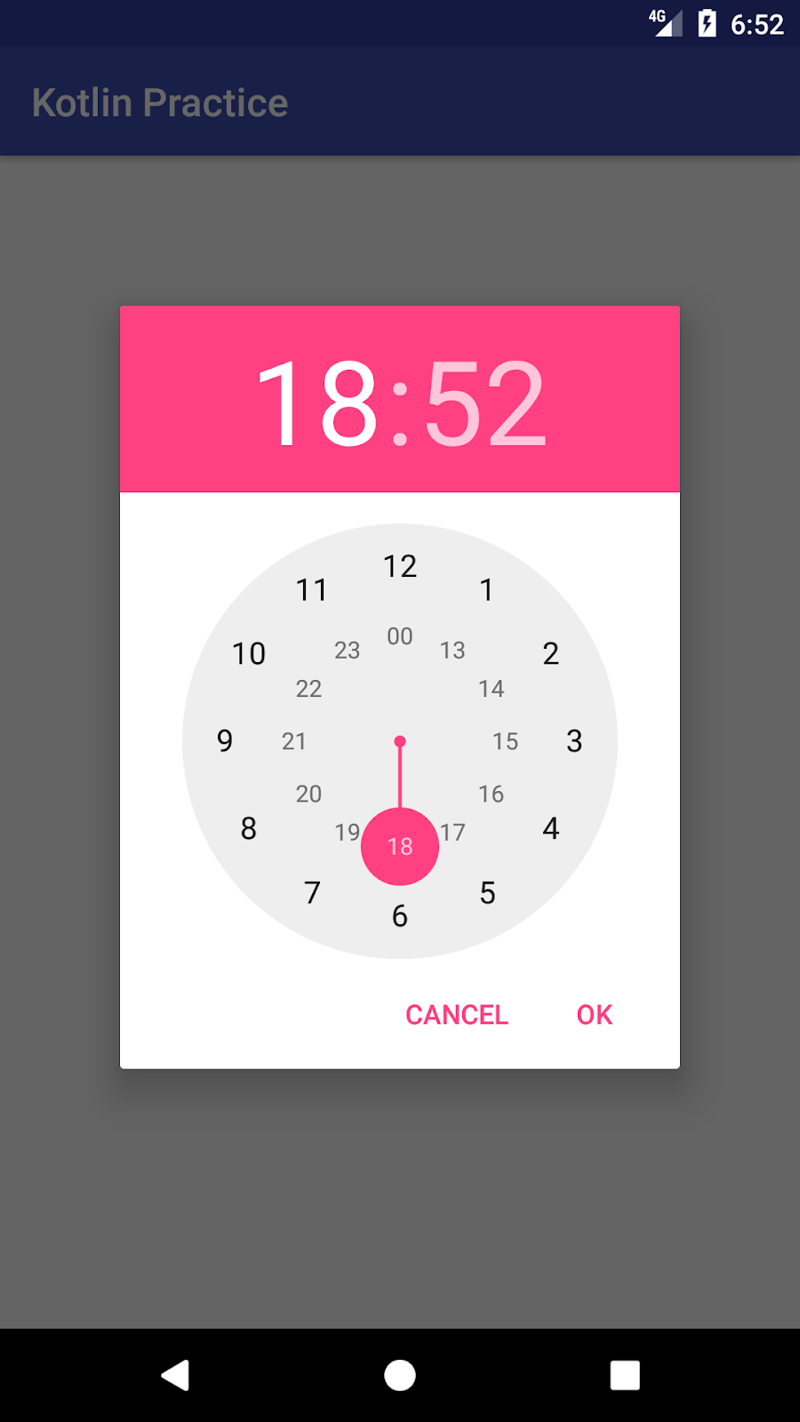
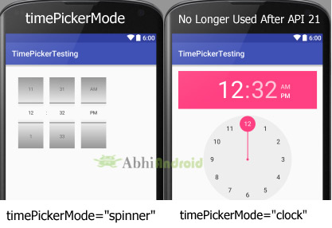
Picker Views
TimePicker
TimePicker is a widget used to select a time of the day in either AM/PM mode or 24 hours mode.
The displayed time consist of hours, minutes and clock format.
It provides two modes – Spinner and Clock(Deprecated after API21)
Android also provides TimePickerDialog component.
If we need to show this view as a dialog, then we use a TimePickerDialog class.

Slide 12
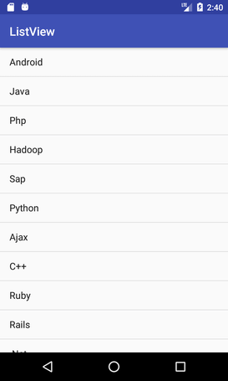
List View
ListView is used when you have to show items in a vertically scrolling list.
It groups several items and displays them in vertical scrollable list.
A ListView is a type of AdapterView.
The list items are automatically inserted to the list using an Adapter that pulls content from a source such as an array or database.
For displaying the items in the ListView setAdaptor() method is used.
An adapter is a bridge between UI components and the data source that fill data into UI Component. Adapter holds the data and send the data to adapter view; the view can take the data from adapter view and fills it in different views.

Slide 13
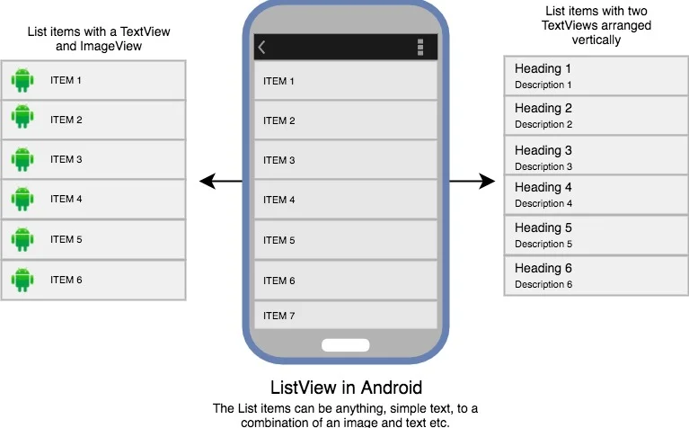
List View

Slide 14
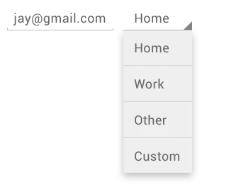
Spinner View
A Spinner is an adapter view that hold items in form of a dropdown menu available for user selection.
It creates a menu with multiple options where a user can select any one option.
It shows a dropdown list of all values when we click on it.
The default value of the android spinner will be the currently selected value
By using Adapter we can easily bind the items to the spinner objects.

Slide 15
Specialized Fragments
List Fragment
A list fragment is a fragment that contains a ListView, displaying a list of items from a data source such as an array or a Cursor.
It exposes event handlers when the user selects an item from the list hosted in the list fragment.
To create a list fragment, you need to extend the ListFragment base class.
Dialog Fragment
A dialog fragment floats on top of an activity and is displayed modally.
Dialog fragments are useful when you need to obtain the user’s response before continuing with execution.
To create a dialog fragment, you need to extend the DialogFragment base class.

Slide 16
Specialized Fragments
Preference Fragment
Android applications will typically provide preferences that allow users to personalize the application.
Preference fragment is used to display an activity for the user to edit the preferences.
To create a preference fragment, you need to extend the PreferenceFragment base class.

Slide 17
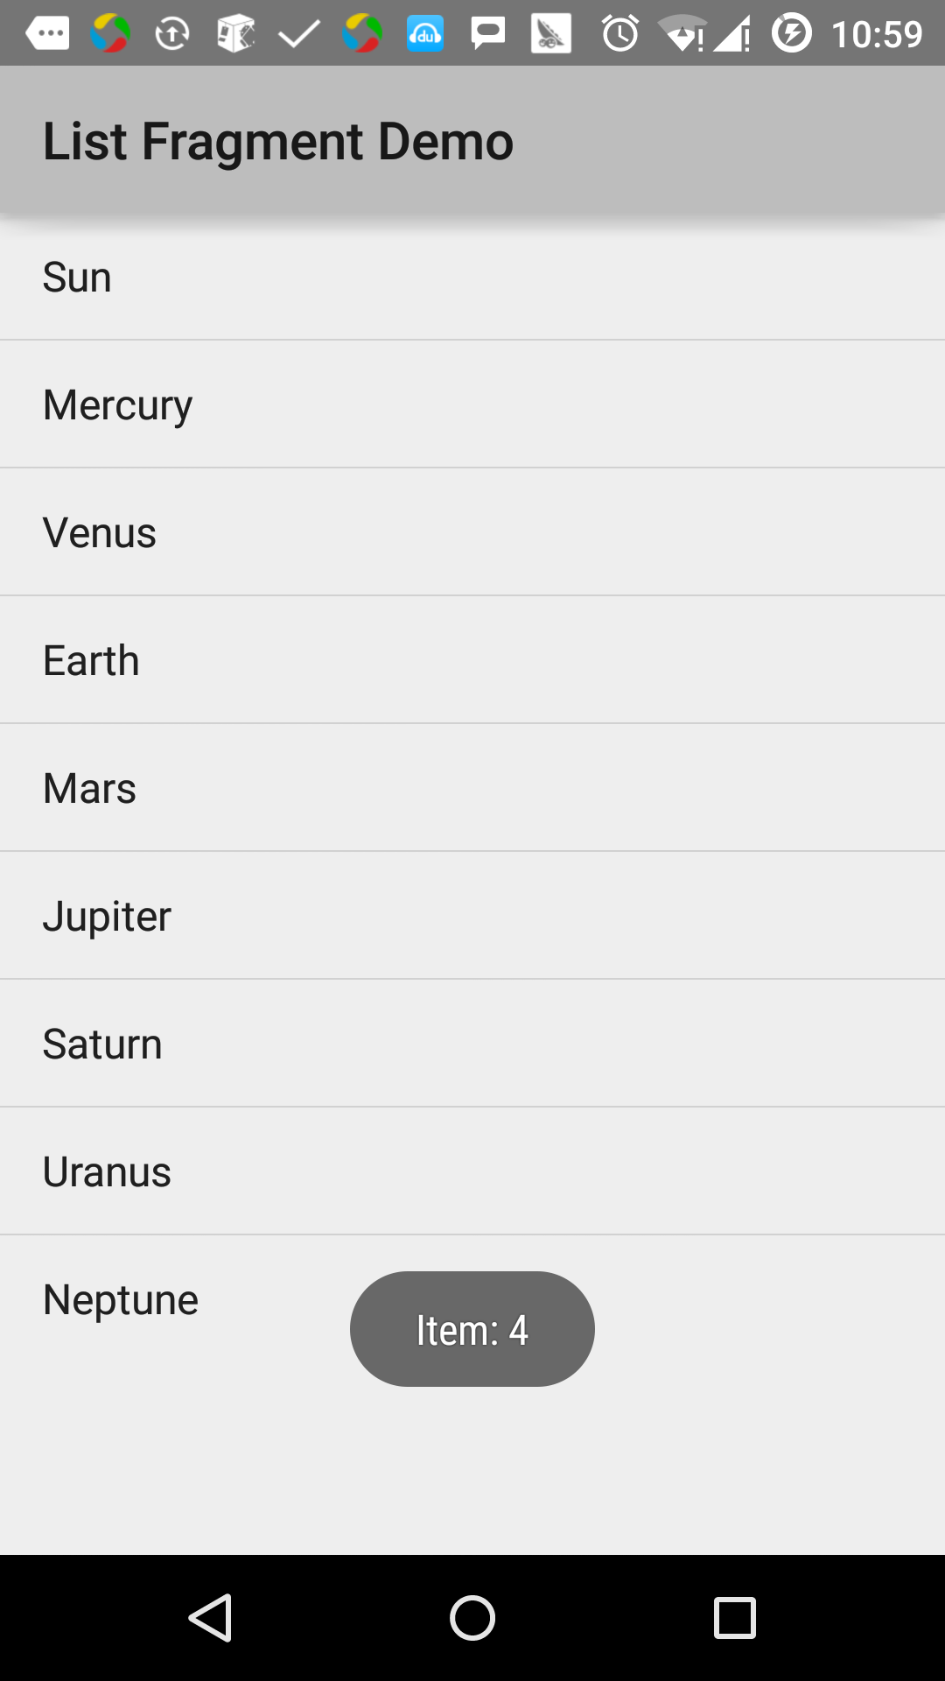
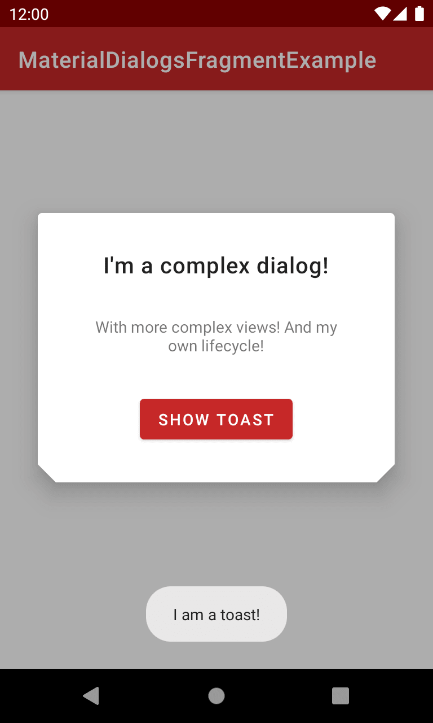
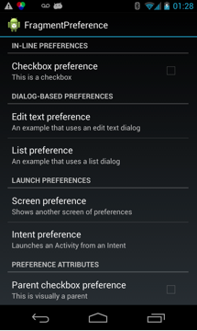
Specialized Fragments

Slide 18


